Slide 1
The role of epithelial cytokines in asthma control and remission
Pascal Chanez

Slide 2
Conflict of interest disclosures
Advisor for AstraZeneca, Boehringer Ingelheim, Boston Scientific, Chiesi, GSK, Novartis, Sanofi, SNCF and Teva
Advisory boards for AB Science, ALK, Argenx, AstraZeneca, Boehringer Ingelheim, Chiesi, GSK, Novartis, Sanofi and Teva
Received honoraria from ALK, AstraZeneca, Boehringer Ingelheim, Boston Scientific, Chiesi, GSK, Novartis and Teva
Received grants from ALK, AstraZeneca, Boehringer Ingelheim, Boston Scientific, GSK, Novartis and Roche
Elected President of the scientific committee of La Fondation du Souffle (2020–2025)
2

Slide 3
Progression of airway remodelling in the asthmatic lung^{1–5}
In the asthmatic airway, repetitive or prolonged damage can lead to an aberrant repair response^{1–4}
The healthy airway is capable of self-repair in response to transient damage^{1,2}
Reversible airway remodelling
Established airway remodelling
Transient damage
Repetitive damage
Prolonged damage
Acute inflammation
Chronic inflammation
Resolution of inflammation
Failed resolution of inflammation
Healing of damage
Over time, accumulation of damage results in structural changes that affect clinical outcomes in asthma^{1,5}
Aberrant repair and airway remodelling
Structural changes, such as epithelial disruption, may in turn exacerbate the response to damage and drive a vicious cycle of airway remodelling³
1. Fehrenbach H, et al. Cell Tissue Res 2017;367:551–569; 2. Crosby LM, Waters CM. Am J Physiol Lung Cell Mol Physiol 2010;298:L715–L731; 3. Yang Y, et al. Clin Respir J 2021;15:1027–1045; 4. Beckett PA, Howarth PH. Thorax 2003;58:163–174; 5. Hough KP, et al. Front Med 2020;7:191
Notes:
Fehrenbach H, Wagner C, Wegmann M. Airway remodeling in asthma: what really matters. Cell Tissue Res 2017 Mar;367(3):551–569
Crosby LM, Waters CM. Epithelial repair mechanisms in the lung. Am J Physiol Lung Cell Mol Physiol 2010 Jun;298(6):L715–L731
Yang Y, Jia M, Ou Y, et al. Mechanisms and biomarkers of airway epithelial cell damage in asthma: a review. Clin Respir J 2021 Oct;15(1):1027–1045
Beckett PA, Howarth PH. Pharmacotherapy and airway remodelling in asthma? Thorax 2003 Feb;58(2):163–174
Hough KP, Curtiss ML, Blain TJ, et al. Airway remodeling in asthma. Front Med 2020 May 21;7:191

Slide 4
Clinical consequences of airway remodelling^{1–6}
Goblet cell metaplasia and increased mucus production¹
Increased basal membrane thickness¹
Airway smooth muscle hyperplasia and hypertrophy²
Subepithelial fibrosis⁵
Epithelial shedding^{3,4}
Angiogenesis⁶
Airway obstruction
Airway hyperresponsiveness and exacerbations
Exacerbations
Airway obstruction
Perpetuation of chronic inflammation
Airway obstruction
Images adapted from Rosen Y. Bronchial goblet cell hyperplasia. 2009. In: Atlas of pulmonary pathology. Available from: https://www.flickr.com/photos/pulmonary_pathology/3705951876 (Accessed 28 June 2023), Shifren A, et al. J Allergy (Cairo) 2012;2012:316049, Doeing DC, Solway J. J Appl Physiol (1985) 2013;114:834–843, Kubo T, et al. Lab Invest 2019;99:158–168, Gordon IO, et al. Arch Pathol Lab Med 2009;133:1096–1105 and Galambos C, et al. Ann Am Thorac Soc 2018;15:1359–1362 1. Bartemes KR, Kita H. Clin Immunol 2012;143:222–235; 2. Doeing DC, Solway J. J Appl Physiol 2013;114:834–843; 3. Yang Y, et al. Clin Respir J 2021;15:1027–1045; 4. Frey A, et al. Front Immunol 2020;11:761; 5. Cohen L, et al. Am J Respir Crit Care Med 2007;176:138–145; 6. Keglowich LF, Borger P. Open Respir Med J 2015;9:70–80
4
Notes:
Images adapted from Rosen Y. Bronchial goblet cell hyperplasia. 2009. In: Atlas of pulmonary pathology. Available from: https://www.flickr.com/photos/pulmonary_pathology/3705951876 (Accessed 28 June 2023), Shifren A, Witt C, Christie C, et al. Mechanisms of remodeling in asthmatic airways. J Allergy (Cairo) 2012;2012:316049, Doeing DC, Solway J. Airway smooth muscle in the pathophysiology and treatment of asthma. J Appl Physiol (1985) 2013 Apr;114(7):834–843, Kubo T, Tsujiwaki M, Hirohashi Y, et al. Differential bronchial epithelial response regulated by ΔNp63: a functional understanding of the epithelial shedding found in asthma. Lab Invest 2019 Feb;99(2):158–168, Gordon IO, Cipriani N, Arif Q, et al. Update in nonneoplastic lung diseases. Arch Pathol Lab Med 2009 Jul;133(7):1096–1105 and Galambos C, Bates ML, Bush D, et al. Prominent bronchopulmonary vascular anastomoses in fatal childhood asthma. Ann Am Thorac Soc 2018 Nov;15(11):1359–1362
Bartemes KR, Kita H. Dynamic role of epithelium-derived cytokines in asthma. Clin Immunol 2012 Jun;143(3):222–235
Doeing DC, Solway J. Airway smooth muscle in the pathophysiology and treatment of asthma. J Appl Physiol 2013 Apr;114(7):834–843
Yang Y, Jia M, Ou Y, et al. Mechanisms and biomarkers of airway epithelial cell damage in asthma: a review. Clin Respir J 2021 Oct;15(10):1027–1045
Frey A, Lunding LP, Ehlers JC, et al. More than just a barrier: the immune functions of the airway epithelium in asthma pathogenesis. Front Immunol 2020 Apr 28;11:761
Cohen L, Xueping E, Tarsi J, et al. Epithelial cell proliferation contributes to airway remodeling in severe asthma. Am J Respir Crit Care Med 2007 Jul 15;176(2):138–145
Keglowich LF, Borger P. The three A’s in asthma – airway smooth muscle, airway remodeling & angiogenesis. Open Respir Med J 2015 Jun 17;9:70–80

Slide 5
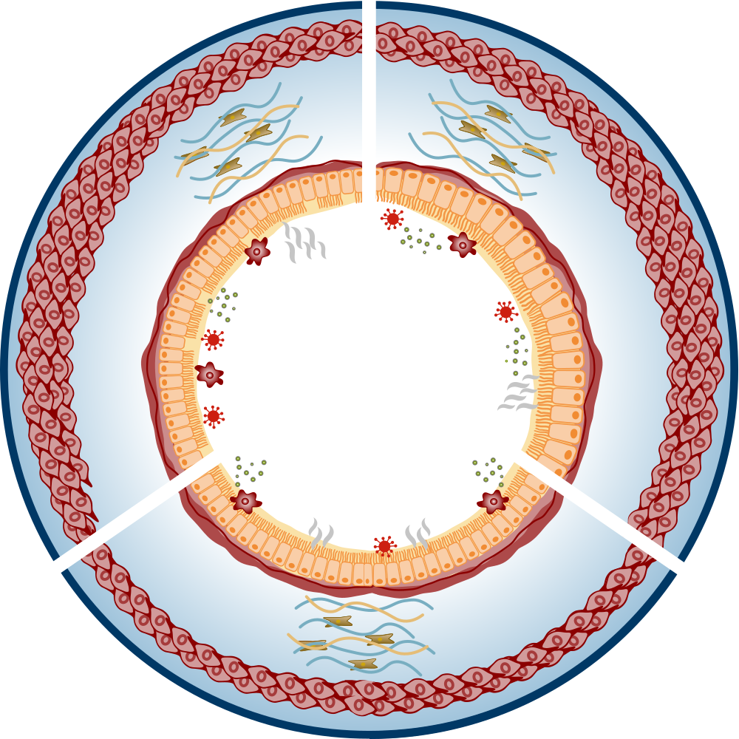
Epithelial cytokines can play diverse, yet often overlapping, roles in airway remodelling in asthma^{1–9}
TSLP
IL-33
IL-25
Evidence based on in-vitro experimental data IL, interleukin; TSLP, thymic stromal lymphopoietin 1. Gregory LG, et al. Thorax 2013;68:82–90; 2. Xu X, et al. Exp Biol Med (Maywood) 2019;244:770–780; 3. Saglani S, et al. J Allergy Clin Immunol 2013;132:676–685; 4. Guo Z, et al. J Asthma 2014;51:863–869; 5. Kaur D, et al. Allergy 2015;70:556–567; 6. Cao L, et al. Exp Lung Res 2018;44:288–301; 7. Jin A, et al. Biochim Biophys Acta Mol Cell Res 2021;1868:119083; 8. Cai L-M, et al. Exp Lung Res 2019;45:221–235; 9. Redhu NS, et al. Sci Rep 2013;3:2301
5
Notes:
Gregory LG, Jones CP, Walker SA, et al. IL-25 drives remodelling in allergic airways disease induced by house dust mite. Thorax 2013 Jan;68(1):82–90
Xu X, Luo S, Li B, et al. IL-25 contributes to lung fibrosis by directly acting on alveolar epithelial cells and fibroblasts. Exp Biol Med (Maywood) 2019 Jun;244(9):770–780
Saglani S, Liu S, Ullman N, et al. IL-33 promotes airway remodeling in pediatric patients with severe steroid-resistant asthma. J Allergy Clin Immunol 2013 Sep;132(3):676–685
Guo Z, Wu J, Zhao J, et al. IL-33 promotes airway remodeling and is a marker of asthma disease severity. J Asthma 2014 Oct;51(8):863–869
Kaur D, Gomez E, Doe C, et al. IL-33 drives airway hyper-responsiveness through IL-13-mediated mast cell: airway smooth muscle crosstalk. Allergy 2015 May;70(5):556–567
Cao L, Liu F, Liu Y, et al. TSLP promotes asthmatic airway remodeling via p38-STAT3 signaling pathway in human lung fibroblast. Exp Lung Res 2018 Aug;44(6):288–301
Jin A, Tang X, Zhai W, et al. TSLP-induced collagen type-I synthesis through STAT3 and PRMT1 is sensitive to calcitriol in human lung fibroblasts. Biochim Biophys Acta Mol Cell Res 2021 Sep;1868(10):119083
Cai L-M, Zhou Y-Q, Yang L-F, et al. Thymic stromal lymphopoietin induced early stage of epithelial-mesenchymal transition in human bronchial epithelial cells through upregulation of transforming growth factor beta 1. Exp Lung Res 2019 Oct;45(8):221–235
Redhu NS, Shan L, Movassagh H, et al. Thymic stromal lymphopoietin induces migration in human airway smooth muscle cells. Sci Rep 2013;3:2301

Slide 6
Epithelial cytokines can play diverse, yet often overlapping, roles in airway remodelling in asthma^{1,2}
TSLP
TSLP
IL-33
IL-25 drives collagen secretion by lung fibroblasts¹
IL-25 promotes the proliferation of lung fibroblasts²
IL-25
Evidence based on in-vitro experimental data IL, interleukin; TSLP, thymic stromal lymphopoietin 1. Gregory LG, et al. Thorax 2013;68:82–90; 2. Xu X, et al. Exp Biol Med (Maywood) 2019;244:770–780
Notes:
Gregory LG, Jones CP, Walker SA, et al. IL-25 drives remodelling in allergic airways disease induced by house dust mite. Thorax 2013 Jan;68(1):82–90
Xu X, Luo S, Li B, et al. IL-25 contributes to lung fibrosis by directly acting on alveolar epithelial cells and fibroblasts. Exp Biol Med (Maywood) 2019 Jun;244(9):770–780

Slide 7
Evidence for IL-25 in airway remodelling^{1,2}
In human airway lung fibroblasts, IL-25 induced extracellular collagen secretion in vitro¹
In human lung fibroblasts, IL-25 promoted cell proliferation in vitro²
90
IL-25 (N=8–12)
4
†
Collagen (mg/mL)
PBS (N=8–12)
*
*
Optical density
†
75
3
60
45
2
30
*
1
15
0
0
1
10
100
0
8
24
48
N=3
Time (h)
IL-25 concentration (ng/mL)
(72 hour data presented)
Figures adapted from Gregory LG, et al. Thorax 2013;68:82–90 and Xu X, et al. Exp Biol Med (Maywood) 2019;244:770–780 *P<0.05 vs PBS control group; †P<0.001 compared with vehicle-treated fibroblasts after 72 hours IL, interleukin; PBS, phosphate-buffered saline 1. Gregory LG, et al. Thorax 2013;68:82–90; 2. Xu X, et al. Exp Biol Med (Maywood) 2019;244:770–780
7
Notes:
Gregory LG, Jones CP, Walker SA, et al. IL-25 drives remodelling in allergic airways disease induced by house dust mite. Thorax 2013 Jan;68(1):82–90
Xu X, Luo S, Li B, et al. IL-25 contributes to lung fibrosis by directly acting on alveolar epithelial cells and fibroblasts. Exp Biol Med (Maywood) 2019 Jun;244(9):770–780

Slide 8
Epithelial cytokines can play diverse, yet often overlapping, roles in airway remodelling in asthma^{1–5}
TSLP
IL-33
IL-33 promotes the expression of ECM components collagen and fibronectin 1 by lung fibroblasts^{3,4}
IL-33 directs airway smooth
muscle wound repair⁵
IL-25 drives collagen secretion by lung fibroblasts¹
IL-25 promotes the proliferation of lung fibroblasts²
IL-25
Evidence based on in-vitro experimental data ECM, extracellular matrix; IL, interleukin; TSLP, thymic stromal lymphopoietin 1. Gregory LG, et al. Thorax 2013;68:82–90; 2. Xu X, et al. Exp Biol Med (Maywood) 2019;244:770–780; 3. Saglani S, et al. J Allergy Clin Immunol 2013;132:676–685; 4. Guo Z, et al. J Asthma 2014;51:863–869; 5. Kaur D, et al. Allergy 2015;70:556–567
8
Notes:
Gregory LG, Jones CP, Walker SA, et al. IL-25 drives remodelling in allergic airways disease induced by house dust mite. Thorax 2013 Jan;68(1):82–90
Xu X, Luo S, Li B, et al. IL-25 contributes to lung fibrosis by directly acting on alveolar epithelial cells and fibroblasts. Exp Biol Med (Maywood) 2019 Jun;244(9):770–780
Saglani S, Liu S, Ullman N, et al. IL-33 promotes airway remodeling in pediatric patients with severe steroid-resistant asthma. J Allergy Clin Immunol 2013 Sep;132(3):676–685
Guo Z, Wu J, Zhao J, et al. IL-33 promotes airway remodeling and is a marker of asthma disease severity. J Asthma 2014 Oct;51(8):863–869
Kaur D, Gomez E, Doe C, et al. IL-33 drives airway hyper-responsiveness through IL-13-mediated mast cell: airway smooth muscle crosstalk. Allergy 2015 May;70(5):556–567

Slide 9
Evidence for IL-33 in airway remodelling^{1–3}
In human lung fibroblasts, IL-33 increased expression of fibronectin 1 and type I collagen in vitro^{1,2}
In human airway smooth muscle cells, IL-33 directed wound closure in vitro, which may contribute to smooth muscle repair in response to physical or inflammatory damage³
Fibronectin 1 / β-actin (N=3)
6
Type I collagen / β-actin (N=3)
40
Relative protein level
Percentage wound healed
P=0.02
5
*
30
4
†
3
†
20
*
2
10
1
0
0
50 ng/mL IL-33
–
IL-33
(ng/mL)
–
1
10
100
+
Figures adapted from Guo Z, et al. J Asthma 2014;51:863–869 and Kaur D, et al. Allergy 2015;70:556–567 *P<0.05 vs controls; †P<0.01 vs controls IL, interleukin 1. Guo Z, et al. J Asthma 2014;51:863–869; 2. Saglani S, et al. J Allergy Clin Immunol 2013;132:676–685; 3. Kaur D, et al. Allergy 2015;70:556–567
9
Notes:
Guo Z, Wu J, Zhao J, et al. IL-33 promotes airway remodeling and is a marker of asthma disease severity. J Asthma 2014 Oct;51(8):863–869
Saglani S, Liu S, Ullman N, et al. IL-33 promotes airway remodeling in pediatric patients with severe steroid-resistant asthma. J Allergy Clin Immunol 2013 Sep;132(3):676–685
Kaur D, Gomez E, Doe C, et al. IL-33 drives airway hyper-responsiveness through IL-13-mediated mast cell: airway smooth muscle crosstalk. Allergy 2015 May;70(5):556–567

Slide 10
Epithelial cytokines can play diverse, yet often overlapping, roles in airway remodelling in asthma^{1–9}
TSLP
TSLP activates lung fibroblasts which produce ECM molecules such as collagen type I and MMP-1^{6,7}
IL-33
IL-33 promotes the expression of ECM components collagen and fibronectin 1 by lung fibroblasts^{3,4}
TSLP induces EMT in epithelial cells through the upregulation of TGF-β⁸
IL-33 directs airway smooth
muscle wound repair⁵
TSLP promotes migration and proliferation of airway smooth muscle cells⁹
IL-25 drives collagen secretion by lung fibroblasts¹
IL-25 promotes the proliferation of lung fibroblasts²
IL-25
Evidence based on in-vitro experimental data IL, interleukin; TSLP, thymic stromal lymphopoietin 1. Gregory LG, et al. Thorax 2013;68:82–90; 2. Xu X, et al. Exp Biol Med (Maywood) 2019;244:770–780; 3. Saglani S, et al. J Allergy Clin Immunol 2013;132:676–685; 4. Guo Z, et al. J Asthma 2014;51:863–869; 5. Kaur D, et al. Allergy 2015;70:556–567; 6. Cao L, et al. Exp Lung Res 2018;44:288–301; 7. Jin A, et al. Biochim Biophys Acta Mol Cell Res 2021;1868:119083; 8. Cai L-M, et al. Exp Lung Res 2019;45:221–235; 9. Redhu NS, et al. Sci Rep 2013;3:2301
10
Notes:
Gregory LG, Jones CP, Walker SA, et al. IL-25 drives remodelling in allergic airways disease induced by house dust mite. Thorax 2013 Jan;68(1):82–90
Xu X, Luo S, Li B, et al. IL-25 contributes to lung fibrosis by directly acting on alveolar epithelial cells and fibroblasts. Exp Biol Med (Maywood) 2019 Jun;244(9):770–780
Saglani S, Liu S, Ullman N, et al. IL-33 promotes airway remodeling in pediatric patients with severe steroid-resistant asthma. J Allergy Clin Immunol 2013 Sep;132(3):676–685
Guo Z, Wu J, Zhao J, et al. IL-33 promotes airway remodeling and is a marker of asthma disease severity. J Asthma 2014 Oct;51(8):863–869
Kaur D, Gomez E, Doe C, et al. IL-33 drives airway hyper-responsiveness through IL-13-mediated mast cell: airway smooth muscle crosstalk. Allergy 2015 May;70(5):556–567
Cao L, Liu F, Liu Y, et al. TSLP promotes asthmatic airway remodeling via p38-STAT3 signaling pathway in human lung fibroblast. Exp Lung Res 2018 Aug;44(6):288–301
Jin A, Tang X, Zhai W, et al. TSLP-induced collagen type-I synthesis through STAT3 and PRMT1 is sensitive to calcitriol in human lung fibroblasts. Biochim Biophys Acta Mol Cell Res 2021 Sep;1868(10):119083
Cai L-M, Zhou Y-Q, Yang L-F, et al. Thymic stromal lymphopoietin induced early stage of epithelial-mesenchymal transition in human bronchial epithelial cells through upregulation of transforming growth factor beta 1. Exp Lung Res 2019 Oct;45(8):221–235
Redhu NS, Shan L, Movassagh H, et al. Thymic stromal lymphopoietin induces migration in human airway smooth muscle cells. Sci Rep 2013;3:2301

Slide 11
Evidence for TSLP in airway remodelling^{1–4}
In human lung fibroblasts, TSLP increased expression of collagen and alpha-smooth muscle actin in vitro^{1,2}
In human airway smooth muscle cells, TSLP induced migration, which may contribute to increased smooth muscle mass in vitro³
In human airway epithelial cells, TSLP downregulated epithelial marker E-cadherin and upregulated mesenchymal marker vimentin in vitro⁴
250
Alpha-smooth muscle actin (N=3) Collagen (N=3)
Migrated cell number
E-cadherin (N=3) Vimentin (N=3)
1.0
†
†
2.0
¶
Relative protein level
200
§
¶
*
Protein level
¶
*
1.5
¶
150
‡
¶
¶
0.5
100
1.0
¶
50
0.5
0
0
0
0
1.5
2.5
4.0
Medium
TSLP (1 ng/mL)
TSLP (10 ng/mL)
0
1
10
100
TSLP concentration (ng/mL)
TSLP concentration (ng/mL)
N=4
Figures adapted from Cao L, et al. Exp Lung Res 2018;44:288–301, Redhu NS, et al. Sci Rep 2013;3:2301 and Cai L-M, et al. Exp Lung Res 2019;45:221–235 *P<0.05 vs GAPDH control (smooth muscle actin); †P<0.05 vs GAPDH control (collagen); ‡P<0.001 vs medium control; §P<0.01; ¶P<0.001
GAPDH, glyceraldehyde-3-phosphate dehydrogenase; TSLP, thymic stromal lymphopoietin
1. Cao L, et al. Exp Lung Res 2018;44:288–301; 2. Wu J, et al. Cell Biochem Funct 2013;31:496–503; 3. Redhu NS, et al. Sci Rep 2013;3:2301; 4. Cai L-M, et al. Exp Lung Res 2019;45:221–235
11
Notes:
Cao L, Liu F, Liu Y, et al. TSLP promotes asthmatic airway remodeling via p38-STAT3 signaling pathway in human lung fibroblast. Exp Lung Res 2018 Aug;44(6):288–301
Wu J, Liu F, Zhao J, et al. Thymic stromal lymphopoietin promotes asthmatic airway remodelling in human lung fibroblast cells through STAT3 signalling pathway. Cell Biochem Funct 2013 Aug;31(6):496–503
Redhu NS, Shan L. Movassagh H, et al. Thymic stromal lymphopoietin induces migration in human airway smooth muscle cells. Sci Rep 2013;3:2301
Cai L-M, Zhou Y-Q, Yang L-F, et al. Thymic stromal lymphopoietin induced early stage of epithelial-mesenchymal transition in human bronchial epithelial cells through upregulation of transforming growth factor beta 1. Exp Lung Res 2019 Oct;45(8):221–235

Slide 12
Genetic and environmental factors in asthma remission: a matter of the epithelium¹
Understanding of the mechanisms underlying whether asthma persists or undergoes apparent spontaneous resolution are not yet understood, but may in part involve the epithelium¹
Bronchial biopsies show enrichment for genes related to the ciliated epithelium in patients in asthma remission¹*
When comparing patients in remission with healthy controls, DNA methylation is observed at genes associated with epithelial cells¹
Expression of genes related to the ciliated epithelium was elevated in remission compared with healthy controls¹
Differential methylation in bronchial biopsies from patients in asthma remission by cell type¹
Cell type
Basal 2
Ciliated
Goblet ciliated
Basal1
Basal activated
Submucosal gland
Basal cycling
Club cells
Goblet
Ionocytes
Vascular endothelium
Fibroblasts
B-cells
T-cells
Mast cells
Smooth muscle
Pulmonary dendritic
Luminal macrophages
Neutrophils
Cycling
20000
15000
10000
Rank statistic
DNA methylation is an important epigenetic modification that regulates gene transcription, and has been associated with asthma pathophysiology¹
5000
0
*Patients were considered to be in clinical remission if they had not had an asthma attack or wheeze in the past three years and did not use asthma medication. Asthma patients were considered to be in complete remission if, in addition to the previous criteria, they did not have airway hyperresponsiveness to both histamine and AMP, and had no signs of airflow obstruction
AMP, adenosine 5′-monophosphate 1. Vermeulen CJ, et al. Eur Respir J 2020;55:1901280
Notes:
Vermeulen CJ, Xu C-J, Vonk JM, et al. Differential DNA methylation in bronchial biopsies between persistent asthma and asthma in remission. Eur Respir J 2020 Feb 6;55(2):1901280

Slide 13
Summary
In asthma, airway remodelling refers to structural changes that can occur in both the small and large airways¹
Airway remodelling is heterogeneous, can be observed across the spectrum of asthma severity, and can be either reversible or irreversible^{1–3}
Epithelial cytokines can play roles in airway remodelling in asthma⁴
The mechanisms underlying whether asthma persists or undergoes apparent spontaneous resolution are not yet understood, but may in part involve the epithelium⁵
Improved disease stability and consideration of remission as a management goal for patients living with asthma remains a long-term aspiration to improve patient care^{6,7}
1. Varricchi G, et al. Allergy 2022;77:3538–3552; 2. Hsieh A, et al. Front Physiol 2023 Jan 19;14:1113100; 3. Fehrenbach H, et al. Cell Tissue Res 2017;367:551–569; 4. Porsbjerg CM, et al. Eur Respir J 2020;56:2000260; 5. Vermeulen CJ, et al. Eur Respir J 2020;55:1901280; 6. Menzies-Gow A, et al. J Allergy Clin Immunol 2020;145:757–765; 7. Thomas D, et al. Eur Respir J 2022;60:2102583
Notes:
Varricchi G, Ferri S, Pepys J, et al. Biologics and airway remodeling in severe asthma. Allergy 2022 Dec;77(12):3538–3552
Hsieh A, Assadinia N, Hackett T-L. Airway remodeling heterogeneity in asthma and its relationship to disease outcomes. Front Physiol 2023 Jan 19;14:1113100
Fehrenbach H, Wagner C, Wegmann M. Airway remodeling in asthma: what really matters. Cell Tissue Res 2017 Mar;367(3):551–569
Porsbjerg CM, Sverrild A, Lloyd CM, et al. Anti-alarmins in asthma: targeting the airway epithelium with next-generation biologics. Eur Respir J 2020 Nov 12;56(5):2000260
Vermeulen CJ, Xu C-J, Vonk JM, et al. Differential DNA methylation in bronchial biopsies between persistent asthma and asthma in remission. Eur Respir J 2020 Feb 6;55(2):1901280
Menzies-Gow A, Bafadhel M, Busse WW, et al. An expert consensus framework for asthma remission as a treatment goal. J Allergy Clin Immunol 2020 Mar;145(3):757–765
Thomas D, McDonald VM, Pavord ID, et al. Asthma remission: what is it and how can it be achieved? Eur Respir J 2022 Nov 3;60(5):2102583

Slide 14
The future of severe asthma^{1,2}
TODAY
THE FUTURE
Asthma conception
Prevention
Achieve asthma control by reducing the traits
Stop and reverse mechanisms to fully stabilise the disease
Asthma progression
Improved disease stability and consideration of remission as a management goal for patients living with asthma remains a long-term aspiration to improve patient care^{1,2}
Conceptual model based on the speaker’s own opinion 1. Menzies-Gow A, et al. J Allergy Clin Immunol 2020;145:757–765; 2. Thomas D, et al. Eur Respir J 2022;60:2102583
Notes:
Menzies-Gow A, Bafadhel M, Busse WW, et al. An expert consensus framework for asthma remission as a treatment goal. J Allergy Clin Immunol 2020 Mar;145(3):757–765
Thomas D, McDonald VM, Pavord ID, et al. Asthma remission: what is it and how can it be achieved? Eur Respir J 2022 Nov 3;60(5):2102583

